Slide 1
Markov Decision Processes
The date for Midterm 2 has been set. It is Dec 19.
HW5 is due Oct 25
Notes:
Reading: Chapter 17. Non-deterministic search.
So far, we've mainly examined deterministic problem settings, where the outcome of every action that we take is perfectly predictable. In this module, we'll introduce the notion of a stc. Or probabilistic task environment where the agent will have to figure out what's the best action to take, even when the outcome of that action is uncertain, we'll introduce a new problem formulation called a Markov decision process, or MDP for short.
MDPs are a kind of non-deterministic search problem. They're applicable in a fully observable task environment where we have to make a sequence of decisions. And where the outcome of our actions is non-deterministic. In the previous search problems that we've looked at, the solution has always been a plan.
The plan corresponds to the shortest sequence of actions that we could take to go from our start state to one of our goal states. However, because of the non-determinism in MDPs, that kind of single sequence of actions is not gonna work as a solution . You can imagine that if you executed that sequence of actions, you may end up in a state that isn't a goal state.
Therefore, we're gonna need a different kind of solution to MDPs. A solution for an MDP is gonna be something new called the policy. A policy takes in a state and returns the best action that an agent could take when it finds itself in that. . One way of solving MDPs is via the Expect AAC search algorithm, which we saw in the games and adversarial search module.
We'll also take a look at several other algorithms for solving MDPs, including value iteration and policy iteration. MDPs will also introduce other important concepts like the notion of additive rewards and the notion of a probabilistic transition. , all of the components that we learn about in this MDP module will also be very useful when we reach the reinforcement learning module.

Slide 2
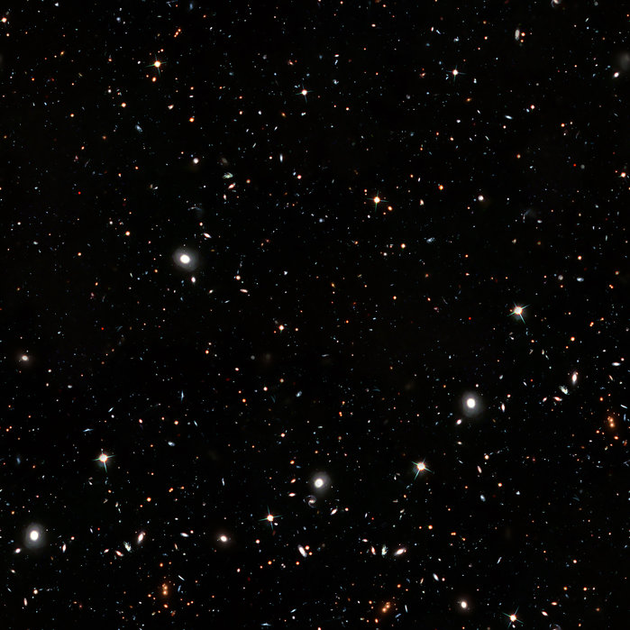
Navigating an Asteroid Field
Suppose we have a fully-observable 4x3 environment with goal states.
The millennium falcon begins in the start state and picks an action at each time step.
Actions: Up, Down, Left, Right
The game terminates when it reaches a goal state (+1 or -1).
If the environment were deterministic, the solution would be easy:
[Up, Up, Right, Right, Right]
+1
3
–1
–1
2
1
1
2
3
4
Notes:
If it tries to leave the asteroid field it stays in its current square.

Slide 3

Navigating an Asteroid Field
Instead of making the environment deterministic, we will make it stochastic.
If the Falcon selects the action Up then it only moves up 80% of the time.
10% of the time the weird gravity fields cause it to veer off to the left or right.
+1
3
–1
–1
0.8
2
Transition Model:
0.1
Action: Up
0.1
1
1
2
3
4

Slide 4
Navigating an Asteroid Field
For action sequence
[Up, Up, Right, Right, Right],
what’s the probability that the millennium falcon reaches the intended goal?
+1
3
–1
–1
0.8
2
Transition Model:
0.1
Action: Up
0.1
1
1
2
3
4
Notes:
http://www.bluemilkspecial.com/comic/wampa-cave-3/

Slide 5
Navigating an Asteroid Field
For action sequence
[Up, Up, Right, Right, Right],
what’s the probability that the millennium falcon reaches the intended goal?
+1
3
0.8
–1
–1
0.8
2
Transition Model:
0.1
Action: Up
0.1
1
1
2
3
4
Notes:
http://www.bluemilkspecial.com/comic/wampa-cave-3/

Slide 6
Navigating an Asteroid Field
For action sequence
[Up, Up, Right, Right, Right],
what’s the probability that the millennium falcon reaches the intended goal?
+1
3
0.8
* 0.8
–1
–1
0.8
2
Transition Model:
0.1
Action: Up
0.1
1
1
2
3
4
Notes:
http://www.bluemilkspecial.com/comic/wampa-cave-3/

Slide 7
Navigating an Asteroid Field
For action sequence
[Up, Up, Right, Right, Right],
what’s the probability that the millennium falcon reaches the intended goal?
+1
3
0.8
* 0.8
* 0.8
–1
–1
2
Transition Model:
0.1
Action:
Right
0.8
1
0.1
1
2
3
4
Notes:
http://www.bluemilkspecial.com/comic/wampa-cave-3/

Slide 8
Navigating an Asteroid Field
For action sequence
[Up, Up, Right, Right, Right],
what’s the probability that the millennium falcon reaches the intended goal?
+1
3
0.8
* 0.8
* 0.8
* 0.8
–1
–1
2
Transition Model:
0.1
Action:
Right
0.8
1
0.1
1
2
3
4
Notes:
http://www.bluemilkspecial.com/comic/wampa-cave-3/

Slide 9
Navigating an Asteroid Field
For action sequence
[Up, Up, Right, Right, Right],
what’s the probability that the millennium falcon reaches the intended goal?
+1
3
0.8
* 0.8
* 0.8
* 0.8
* 0.8
–1
–1
= 0.32768
2
Transition Model:
0.1
Action:
Right
0.8
1
0.1
1
2
3
4
Notes:
http://www.bluemilkspecial.com/comic/wampa-cave-3/

Slide 10
Navigating an Asteroid Field
For action sequence
[Up, Up, Right, Right, Right],
what’s the probability that the millennium falcon reaches the intended goal?
+1
3
–1
–1
0.8
2
Transition Model:
0.1
Action: Up
0.1
1
1
2
3
4
Notes:
http://www.bluemilkspecial.com/comic/wampa-cave-3/

Slide 11
Navigating an Asteroid Field
For action sequence
[Up, Up, Right, Right, Right],
what’s the probability that the millennium falcon reaches the intended goal?
+1
3
0.1
–1
–1
0.8
2
Transition Model:
0.1
Action: Up
0.1
1
1
2
3
4
Notes:
http://www.bluemilkspecial.com/comic/wampa-cave-3/

Slide 12
Navigating an Asteroid Field
For action sequence
[Up, Up, Right, Right, Right],
what’s the probability that the millennium falcon reaches the intended goal?
+1
3
0.1
* 0.1
–1
–1
0.8
2
Transition Model:
0.1
Action: Up
0.1
1
1
2
3
4
Notes:
http://www.bluemilkspecial.com/comic/wampa-cave-3/

Slide 13
Navigating an Asteroid Field
For action sequence
[Up, Up, Right, Right, Right],
what’s the probability that the millennium falcon reaches the intended goal?
+1
3
0.1
* 0.1
* 0.1
–1
–1
2
Transition Model:
0.1
Action:
Right
0.8
1
0.1
1
2
3
4
Notes:
http://www.bluemilkspecial.com/comic/wampa-cave-3/

Slide 14
Navigating an Asteroid Field
For action sequence
[Up, Up, Right, Right, Right],
what’s the probability that the millennium falcon reaches the intended goal?
+1
3
0.1
* 0.1
* 0.1
* 0.1
–1
–1
2
Transition Model:
0.1
Action:
Right
0.8
1
0.1
1
2
3
4
Notes:
http://www.bluemilkspecial.com/comic/wampa-cave-3/

Slide 15
Navigating an Asteroid Field
For action sequence
[Up, Up, Right, Right, Right],
what’s the probability that the millennium falcon reaches the intended goal?
+1
3
0.1
* 0.1
* 0.1
* 0.1
* 0.8
–1
–1
= 0.00008
2
Transition Model:
0.1
Action:
Right
0.8
1
0.1
1
2
3
4
Notes:
http://www.bluemilkspecial.com/comic/wampa-cave-3/

Slide 16
Navigating an Asteroid Field
For action sequence
[Up, Up, Right, Right, Right],
what’s the probability that the millennium falcon reaches the intended goal?
+1
3
0.32768 + 0.00008
The odds of successfully navigating an asteroid field
–1
–1
= 0.32776
2
Transition Model:
0.1
Action:
Right
0.8
1
0.1
1
2
3
4
Notes:
http://www.bluemilkspecial.com/comic/wampa-cave-3/

Slide 17
Stochastic Transition Model
In our search algorithms so far, the transition model was deterministic and described the outcome of each action in each state.
The transition function is sometimes written as T(s, a, s’), or explicitly as a probability:
0.8
0.1
Action: Up
0.1
The probability of
arriving in state s’
p( s’ | s, a )
given that
we are in state s and we selected action a

Slide 18
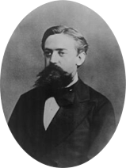
Stochastic Transition Model
In our search algorithms so far, the transition model was deterministic and described the outcome of each action in each state.
The transition function is sometimes written as T(s, a, s’), or explicitly as a probability:
0.8
Andrey Markov (1856-1922)
0.1
Action: Up
0.1
Transitions are Markovian: the probability of arriving in s’ only depends on s and not the history of earlier states.
p( s’ | s, a )
Notes:
Andrey Andreyevich Markov^{[a]} (1856–1922) was a Russian mathematician best known for his work on stochastic processes. A primary subject of his research later became known as Markov chains and Markov processes.^{[2]} Imagine examining the first 20,000 letters of a book, counting frequencies and studying patterns. This is precisely what Andrey Markov did when he analysed the text of Alexander Pushkin's verse novel Eugene Onegin. This work comprises almost 400 stanzas of iambic tetrameter and is a classic of Russian literature

Slide 19
Reward function
We will specify a utility or reward function for the agent.
The “rewards“ can be positive or negative but are bounded by some maximum value.
Because the decision process is sequential, we must specify the utility function on a sequence of states and actions.
Instead of only giving a reward at the goal states, the agent can receive a reward at each time step, based on its transition from s to s’ via action a.
This is defined by a reward function
R( s, a, s’ )
For example, we could give the Millennium Falcon a small negative reward of -0.04 for every transition except for entering the terminal states (+1 for entering the planet’s orbit or -1 for smashing into an asteroid).
The rewards are additive, so if the Millennium Falcon takes 4 steps before entering the planet's orbit, it gets -0.04 + -0.04 + -0.04 + -0.04 + 1 = 0.84 for that solution.

Slide 20
Markov Decision Process
Expectimax node: outcome is uncertain. In expectimax search
we calculate their expected utilities.
A Markov decision process or MDP is
a sequential decision problem
for a fully observable environment
with a stochastic transition model
that has additive rewards
MDPs are non-deterministic search problems. One way of solving them is via expectimax search.
3
12
9
2
4
6
15
6
0

Slide 21

Review: Expectimax
max
chance
min
10
10
9
100
Idea: Uncertain outcomes controlled by chance, not an adversary!
Notes:
At least 10, or otherwise just rather dead; or just 100, or otherwise rather dead; that’s yet something different than minimax or expectimax
Down arrows = min nodes
Circles = chance nodes.

Slide 22
Review: Expectimax Search
Why wouldn’t we know what the result of an action will be?
Explicit randomness: rolling dice
Actions can fail: when moving a robot, wheels might slip
Values should now reflect average-case (expectimax) outcomes, not worst-case (minimax) outcomes
Expectimax search: compute the average score under optimal play
Max nodes as in minimax search
Chance nodes are like min nodes but the outcome is uncertain
Calculate their expected utilities
Take weighted average (expectation) of children
In this module, we’ll learn how to formalize the underlying uncertain-result problems as Markov Decision Processes
max
chance
10
10
4
10
5
9
7
100
Notes:
.

Slide 23
Review: Expectimax Pseudocode
def value(state):
if the state is a terminal state: return the state’s utility
if the next agent is MAX: return max-value(state)
if the next agent is EXP: return exp-value(state)
def max-value(state):
initialize v = -∞
for each successor of state:
v = max(v, value(successor))
return v
def exp-value(state):
initialize v = 0
for each successor of state:
p = probability(successor)
v += p * value(successor)
return v
Notes:
Max is just like before. Exp is the expectation of what will happen next.

Slide 24
Review: Expectimax Pseudocode
def exp-value(state):
initialize v = 0
for each successor of state:
p = probability(successor)
v += p * value(successor)
return v
1/2
1/6
1/3
8
24
-12
$v=\frac{1}{2}⋅(8)+\frac{1}{3}⋅(24)$+ $\frac{1}{6}⋅(−12)$
Notes:
.

Slide 25
Markov Decision Process
To find a solution to an MDP, you need to define the following things:
A set of states s ∈ S
A set of actions a ∈ A
A transition function T(s, a, s’)
Probability that executing action a in s will lead to s’ P(s’ | s, a)
The probability is called the model
A reward function R(s, a, s’)
Sometimes just R(s) or R(s’)
An initial state s₀
Optionally, one or more terminal states

Slide 26
Solution == Policy
In search problems a solution was a sequence of action that corresponded to the shortest path.
Because of the non-determinism in MDPs we cannot simply give a sequence of actions.
Instead, the solution to an MDP is a policy. A policy maps from a state onto the action to take if the agent is in that state.
𝝿(s) = a
+1
–1
or
Policy 𝝿 tells the agent what action to take at state s.
This is an example policy for a grid world

Slide 27
Solution == Policy
In search problems a solution was a plan: a sequence of action that corresponded to the shortest path from the start to a goal.
Because of the non-determinism in MDPs we cannot simply give a sequence of actions.
Instead, the solution to an MDP is a policy. A policy maps from a state onto the action to take if the agent is in that state.
𝝿(s) = a
+1
–1
or

Slide 28
Solution == Policy
In search problems a solution was a plan: a sequence of action that corresponded to the shortest path from the start to a goal.
Because of the non-determinism in MDPs we cannot simply give a sequence of actions.
Instead, the solution to an MDP is a policy. A policy maps from a state onto the action to take if the agent is in that state.
𝝿(s) = a
+1
–1
or

Slide 29
Solution == Policy
In search problems a solution was a plan: a sequence of action that corresponded to the shortest path from the start to a goal.
Because of the non-determinism in MDPs we cannot simply give a sequence of actions.
Instead, the solution to an MDP is a policy. A policy maps from a state onto the action to take if the agent is in that state.
𝝿(s) = a
+1
–1
or

Slide 30
Solution == Policy
In search problems a solution was a plan: a sequence of action that corresponded to the shortest path from the start to a goal.
Because of the non-determinism in MDPs we cannot simply give a sequence of actions.
Instead, the solution to an MDP is a policy. A policy maps from a state onto the action to take if the agent is in that state.
𝝿(s) = a
+1
–1
or

Slide 31
Solution == Policy
In search problems a solution was a plan: a sequence of action that corresponded to the shortest path from the start to a goal.
Because of the non-determinism in MDPs we cannot simply give a sequence of actions.
Instead, the solution to an MDP is a policy. A policy maps from a state onto the action to take if the agent is in that state.
𝝿(s) = a
+1
–1
or

Slide 32
Solution == Policy
In search problems a solution was a plan: a sequence of action that corresponded to the shortest path from the start to a goal.
Because of the non-determinism in MDPs we cannot simply give a sequence of actions.
Instead, the solution to an MDP is a policy. A policy maps from a state onto the action to take if the agent is in that state.
𝝿(s) = a
+1
–1
or

Slide 33
Solution == Policy
In search problems a solution was a plan: a sequence of action that corresponded to the shortest path from the start to a goal.
Because of the non-determinism in MDPs we cannot simply give a sequence of actions.
Instead, the solution to an MDP is a policy. A policy maps from a state onto the action to take if the agent is in that state.
𝝿(s) = a
+1
–1
or

Slide 34
Solution == Policy
In search problems a solution was a plan: a sequence of action that corresponded to the shortest path from the start to a goal.
Because of the non-determinism in MDPs we cannot simply give a sequence of actions.
Instead, the solution to an MDP is a policy. A policy maps from a state onto the action to take if the agent is in that state.
𝝿(s) = a
+1
–1
or

Slide 35
Solution == Policy
Even though the policy told me to go right here, there’s no guarantee that me picking the action Right will result in me moving right. It’s stochastic!
In search problems a solution was a plan: a sequence of action that corresponded to the shortest path from the start to a goal.
Because of the non-determinism in MDPs we cannot simply give a sequence of actions.
Instead, the solution to an MDP is a policy. A policy maps from a state onto the action to take if the agent is in that state.
𝝿(s) = a
+1
–1
or

Slide 36
Solution == Policy
In search problems a solution was a plan: a sequence of action that corresponded to the shortest path from the start to a goal.
Because of the non-determinism in MDPs we cannot simply give a sequence of actions.
Instead, the solution to an MDP is a policy. A policy maps from a state onto the action to take if the agent is in that state.
𝝿(s) = a
+1
–1
or

Slide 37
Solution == Policy
In search problems a solution was a plan: a sequence of action that corresponded to the shortest path from the start to a goal.
Because of the non-determinism in MDPs we cannot simply give a sequence of actions.
Instead, the solution to an MDP is a policy. A policy maps from a state onto the action to take if the agent is in that state.
𝝿(s) = a
+1
–1
or
We will use 𝝿* to denote the optimal policy.

Slide 38
Policies and Rewards
r = -0.04
+1
Even if the same policy is executed multiple times by the agent, this may lead to different sequence of states and actions (environment history), and thus a different score under the reward function.
Therefore we need to compute the expected utility of all the possible paths generated by a policy.
–1
r < -1.65
-0.03 < r < 0
r > 0
ç
+1
+1
+1
–1
–1
–1

Slide 39
Sequences of Rewards
The performance of an agent in an MDP is the sum of the rewards for the transitions it takes.
U_{h}([ s₀, a₀, s₁, a₁ …, s_{n}])
r = -0.04
+1
Utility function on an environment history.
Sequence of states and actions
–1

Slide 40
Sequences of Rewards
The performance of an agent in an MDP is the sum of the rewards for the transitions it takes.
U_{h}([ s₀, a₀, s₁, a₁ …, s_{n}])
r > 0
ç
+1
= R(s₀, a₀, s₁) + R(s₁, a₁, s₂ ) + … + R(s_{n-1}, a_{n-1}, s_{n} )
Utility function on an environment history.
Sequence of states and actions
–1
Bounce around forever, and avoid the exits … infinite rewards!!

Slide 41
Sequences of Rewards
Finite Horizons
Infinite Horizons
Fixed time (N actions) after which the game ends and the agent gets no additional score.
An optimal action can depend on how much time is left.
Policies that depend on time are called nonstationary.
With no fixed time limit, there is no reason to behave differently in the same state at different times.
The optimal policy is stationary.
Infinite horizons are therefore easier.

Slide 42
Utilities Over Time
The performance of an agent in an MDP is the sum of the rewards for the transitions it takes.
U_{h}([ s₀, a₀, s₁, a₁ …, s_{n}])
r > 0
ç
+1
Utility function on an environment history.
Sequence of states and actions
–1
Bounce around forever, and avoid the exits … infinite rewards!!

Slide 43
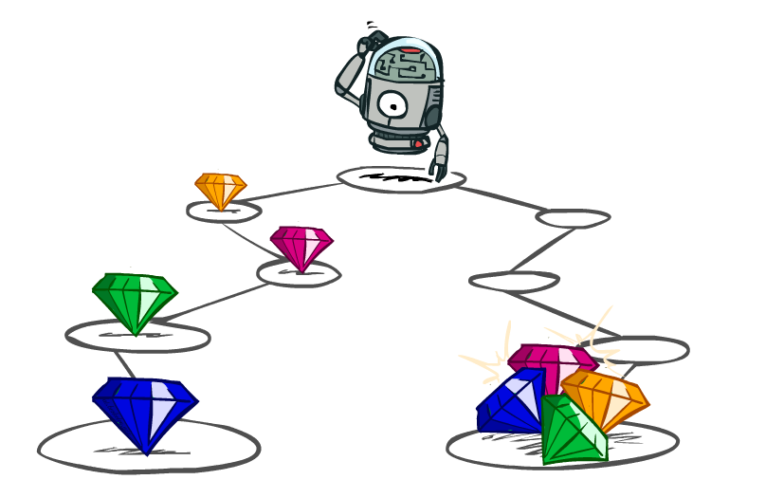
Utilities of Sequences
Slides courtesy of Dan Klein and Pieter Abbeel University of California, Berkeley
Notes:
In MDPs, rewards come to you step by step.
We need to decide what our reward function should be.
For example here, we might have a different way of rewarding this agent. One by giving the rewards incrementally, and one by giving them all at the end.

Slide 44
Utilities of Sequences
What preferences should an agent have over reward sequences?
More or less?
Now or later?
[1, 2, 2]
or
[2, 3, 4]
[0, 0, 1]
or
[1, 0, 0]

Slide 45





Discounting
It’s reasonable to maximize the sum of rewards
It’s also reasonable to prefer rewards now to rewards later
One solution: values of rewards decay exponentially
Worth Now
Worth Next Step
Worth In Two Steps
Notes:
Gamma

Slide 46

Discounting
How to discount?
Each time we descend a level, we multiply in the discount once
Why discount?
Sooner rewards probably do have higher utility than later rewards
Also helps our algorithms converge
Example: discount of 0.5
U([1,2,3]) = 0.5⁰*1 + 0.5¹*2 + 0.5²*3
= 1*1 + 0.5*2 + 0.25*3
U([1,2,3]) < U([3,2,1])
Notes:
Rewards in the future (deeper in the tree) matter less
Interesting: running expectimax, if having to truncate the search, then not losing much; e.g., less then \gamma^d / (1-\gamma)

Slide 47
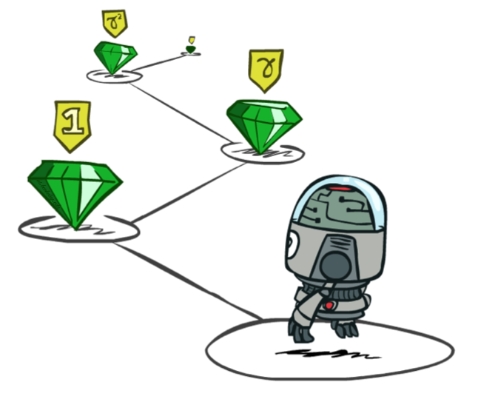
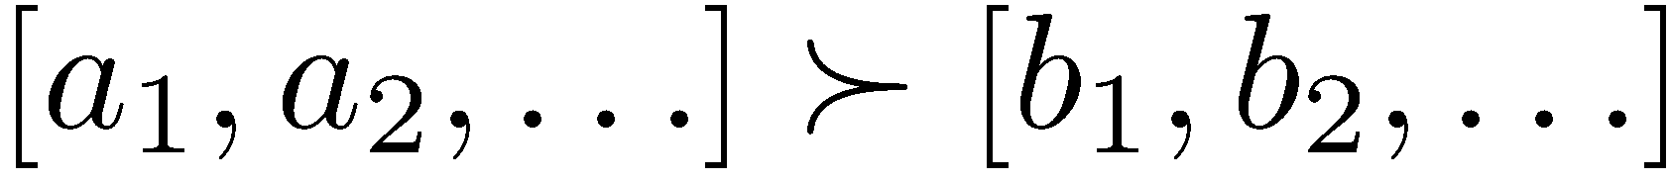
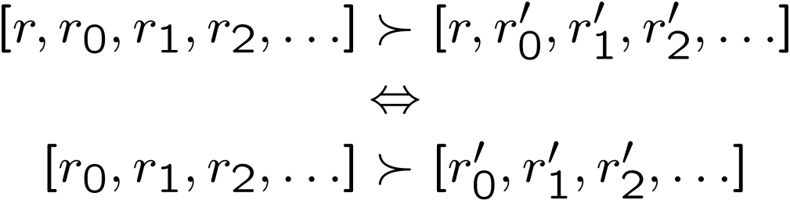
Stationary Preferences
Theorem: if we assume stationary preferences:
Then: there are only two ways to define utilities
Additive utility:
Discounted utility:
Notes:
R is a reward.
Actually only one way, since if gamma were 1, then the discounted utility would be the additive utility.

Slide 48
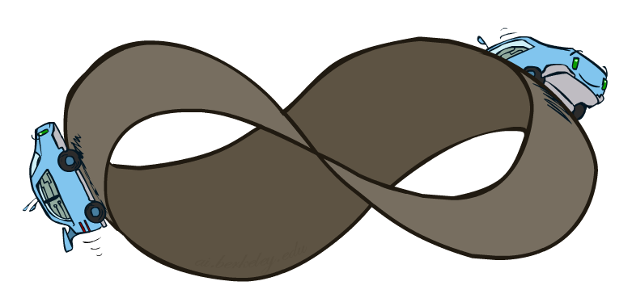
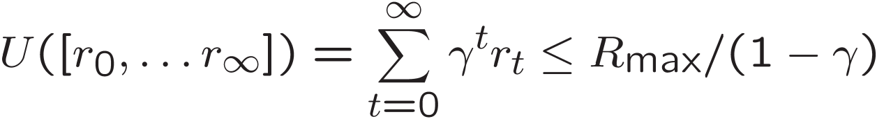
Infinite Utilities?!
Problem: What if the game lasts forever? Do we get infinite rewards?
Solutions:
Finite horizon: (similar to depth-limited search)
Terminate episodes after a fixed T steps (e.g. life)
Gives nonstationary policies (π depends on time left)
Discounting: use 0 < γ < 1
Smaller γ means smaller “horizon” – shorter term focus
Absorbing state: guarantee that for every policy, a terminal state will eventually be reached (like “overheated” for racing)

Slide 49
Recap: Defining MDPs
Markov decision processes:
Set of states S
Start state s₀
Set of actions A
Transitions P(s’|s,a) (or T(s,a,s’))
Rewards R(s,a,s’) (and discount γ)
MDP quantities so far:
Policy = Choice of action for each state
Utility = sum of (discounted) rewards
s
a
s, a
s,a,s’
s’

Slide 50


Example Hyperdrive MDP
The Millennium Falcon needs to travel far far away, quickly
Three states: Cruising, Hyperspace, Crashed
Two actions: Maintain speed, Punch it
Going faster gets double reward
+1
Punch It
0.5
1.0
+1
Maintain
-10
0.5
Maintain
Hyperspace
Punch It
0.5
+2
Cruising
0.5
1.0
+1
+2
Crashed

Slide 51
MDP Search Trees
Each MDP state projects an expectimax-like search tree
s is a state
s
(s, a) is a q-state
a
s, a
(s,a,s’) is called a transition
T(s,a,s’) = P(s’|s,a)
R(s,a,s’)
s,a,s’
s’
Notes:
In MDP chance node represents uncertainty about what might happen based on (s,a) [as opposed to being a random adversary]
Q-state (s,a) is when you were in a state and have committed to take an action an action
Differences with expectimax tree: (1) Transition function encodes the probabilities. (2) Rewards are given on each state of the tree, rather than all the way on the bottom at the terminal nodes.

Slide 52
Hyperdrive Search Tree
+1
+2
+2
+1
+2
+2
+1
+2
+2
+1
+2
-10

Slide 53
Optimal Quantities
The value (utility) of a state s:
V*(s) = expected utility starting in s and acting optimally
The value (utility) of a q-state (s,a):
Q*(s,a) = expected utility starting out having taken action a from state s and (thereafter) acting optimally
The optimal policy:
π*(s) = optimal action from state s
s
s is a state
a
(s, a) is a q-state
s, a
s,a,s’
(s,a,s’) is a transition
s’
Notes:
Pi is a policy. Pi* is the optimal policy from state s.

Slide 54


Values of States
Fundamental operation: compute the (expectimax) value of a state
Expected utility under optimal action
Average sum of (discounted) rewards
This is just what expectimax computed!
Recursive definition of value:
s
a
s, a
s,a,s’
s’
Notes:
Max over chance nodes. That’s really just what expectimax was doing.
What do I do at a chance node Q(s,a).?
I’m going to get a reward. R(s,a,s’). Plus I’m going to get all the future rewards from this state V*(s’).
Both of course, I don’t know what’s going to happen at the chance node, so I need to sum over all states s’
We’re going to weight these by the relative probability that comes from our probability function. We write that T(s,a,s’).
We’re missing one thing. The discount of the future value. So we multiply that by Gamma.
This may look complicated, but you’re going to see this many times in the future. Don’t go into math shock. You can understand this.
We can also write this in one step. We write the expectimax recurrenece.
This is called a Bellman equation. We’re going to come back to this a lot starting in the next lecture.

Slide 55
Hyperdrive Search Tree

Slide 56
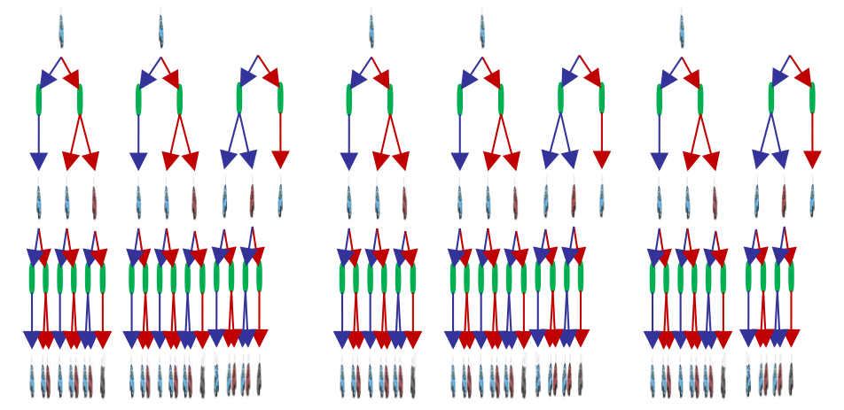
Hyperdrive Search Tree

Slide 57
Hyperdrive Search Tree
We’re doing way too much work with expectimax!
Problem: States are repeated
Idea: Only compute needed quantities once
Problem: Tree goes on forever
Idea: Do a depth-limited computation, but with increasing depths until change is small
Note: deep parts of the tree eventually don’t matter if γ < 1
Notes:
At depth 100, then you have gamma to the 100. So it’s not going to contribute much at all.

Slide 58

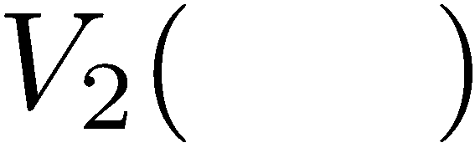
Time-Limited Values
Key idea: time-limited values
Define V_{k}(s) to be the optimal value of s if the game ends in k more time steps
Equivalently, it’s what a depth-k expectimax would give from s
Notes:
V_k is a time limited definition of V(s)

Slide 59
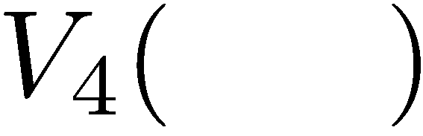
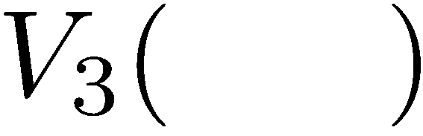
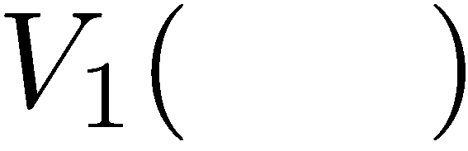
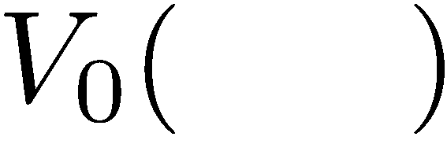
Computing Time-Limited Values
Notes:
V0, we know what it is it’s 0 for any state.
V1, is a depth 1 expectimax computation.
Each layer is a V_k for an increasing value of k.

Slide 60
Markov Decision Processes part 2
Notes:
Reading: Chapter 17. Non-deterministic search.
So far, we've mainly examined deterministic problem settings, where the outcome of every action that we take is perfectly predictable. In this module, we'll introduce the notion of a stc. Or probabilistic task environment where the agent will have to figure out what's the best action to take, even when the outcome of that action is uncertain, we'll introduce a new problem formulation called a Markov decision process, or MDP for short.
MDPs are a kind of non-deterministic search problem. They're applicable in a fully observable task environment where we have to make a sequence of decisions. And where the outcome of our actions is non-deterministic. In the previous search problems that we've looked at, the solution has always been a plan.
The plan corresponds to the shortest sequence of actions that we could take to go from our start state to one of our goal states. However, because of the non-determinism in MDPs, that kind of single sequence of actions is not gonna work as a solution . You can imagine that if you executed that sequence of actions, you may end up in a state that isn't a goal state.
Therefore, we're gonna need a different kind of solution to MDPs. A solution for an MDP is gonna be something new called the policy. A policy takes in a state and returns the best action that an agent could take when it finds itself in that. . One way of solving MDPs is via the Expect AAC search algorithm, which we saw in the games and adversarial search module.
We'll also take a look at several other algorithms for solving MDPs, including value iteration and policy iteration. MDPs will also introduce other important concepts like the notion of additive rewards and the notion of a probabilistic transition. , all of the components that we learn about in this MDP module will also be very useful when we reach the reinforcement learning module.

Slide 61
Example Hyperdrive MDP
The Millennium Falcon needs to travel far far away, quickly
Three states: Cruising, Hyperspace, Crashed
Two actions: Maintain speed, Punch it
Going faster gets double reward
+1
Punch It
0.5
1.0
+1
Maintain
-10
0.5
Maintain
Hyperspace
Punch It
0.5
+2
Cruising
0.5
1.0
+1
+2
Crashed

Slide 62
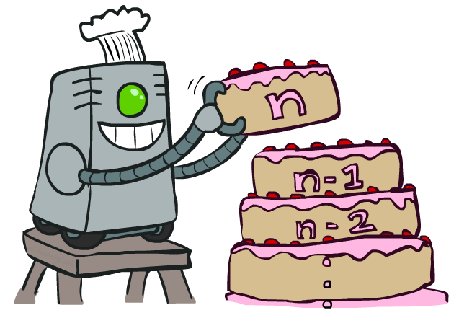
Value Iteration
Notes:
That’s an algorithm called value iteration. You can think of this as building your value from the bottom up. It will behave similarly to expectimax, but will be a lot less work, when we only have a small number of states. Let’s see how it works.

Slide 63
Value Iteration
Start with V₀(s) = 0: no time steps left means an expected reward sum of zero
Given vector of V_{k}(s) values, do one ply of expectimax from each state:
Repeat until convergence
Complexity of each iteration: O(S²A)
Theorem: will converge to unique optimal values
Basic idea: approximations get refined towards optimal values
Policy may converge long before values do
V_{k+1}(s)
a
s, a
s,a,s’
V_{k}(s’)
Notes:
We are going to store all of the V values in a vector. For V_0, everything is just 0.
The recursion is into an Expectimax tree that we have already compted. The recursion won’t actually happen because we’ve already got it.
What will this do, we can go from 0, to 1 to 2, to K. Each time we will go deeper into the tree. When should we stop? When the values start to converge.
Complexity = we do this update for each state, then we do a little expectimax. We do a for loop over A to take take a max over each action, then we do another for loop that goes over each state again.

Slide 64
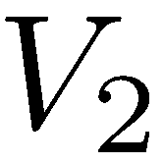
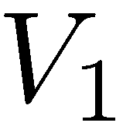
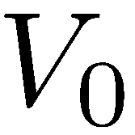
Example: Value Iteration
0.5
+1
Punch It
1.0
+1
Maintain
-10
0.5
Maintain
Hyperspace
Punch It
0.5
+2
1.0
Cruising
0.5
+1
+2
Crashed
Assume no discount!
Notes:
V0 = 0 , 0 , 0
For V1.
On we’re going to do a little expectimax search for each value. As an equation that’s the V_k+1 ….
Let’s start with the cool state. But let’s think about it in terms of actions. What should I do. If I go slow, then I get +1, if I go fast then I get +2.
Now with the fast state, if I go slow then I get +1, if I go fast then I get -10. so max value is 1.
For V2,
Cool:
SLOW If I go slow then what do I get? I get 1, and if there’s no discount, then I’m going to land back at cool, so 2 is the Vk-1. Total is 2.
FAST If I go fast, then I’ve got a 2 instantaneously then I have a 50%/50% chance of plugging in 2 because I got sent back to cool, and plugging in 1 if I go to 1. Total = 3.5
So for cool, the max works out to 3.5
If I work that out for the warm state, then that comes out to 2.5.
As I go further up, then the numbers go up. That makes sense because I’m accumulating rewards at each step.
From this we can work out an optimal policy (when you’re cool go fast when you’re warm go slow).

Slide 65
Example: Value Iteration
0.5
+1
Punch It
1.0
3.5 2.5 0
+1
Maintain
-10
0.5
Maintain
Hyperspace
Punch It
0.5
+2
2 1 0
Cruising
0.5
1.0
+1
+2
Crashed
Assume no discount!
0 0 0
Notes:
V0 = 0 , 0 , 0
For V1.
On we’re going to do a little expectimax search for each value. As an equation that’s the V_k+1 ….
Let’s start with the cool state. But let’s think about it in terms of actions. What should I do. If I go slow, then I get +1, if I go fast then I get +2.
Now with the fast state, if I go slow then I get +1, if I go fast then I get -10. so max value is 1.
For V2,
Cool:
SLOW If I go slow then what do I get? I get 1, and if there’s no discount, then I’m going to land back at cool, so 2 is the Vk-1. Total is 2.
FAST If I go fast, then I’ve got a 2 instantaneously then I have a 50%/50% chance of plugging in 2 because I got sent back to cool, and plugging in 1 if I go to 1. Total = 3.5
So for cool, the max works out to 3.5
If I work that out for the warm state, then that comes out to 2.5.
As I go further up, then the numbers go up. That makes sense because I’m accumulating rewards at each step.
From this we can work out an optimal policy (when you’re cool go fast when you’re warm go slow).

Slide 66
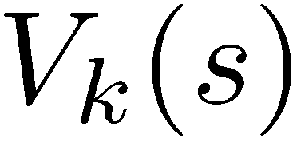
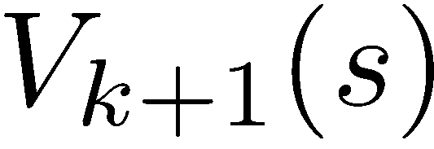
Convergence*
How do we know the V_{k} vectors are going to converge?
Case 1: If the tree has maximum depth M, then V_{M} holds the actual untruncated values
Case 2: If the discount is less than 1
Sketch: For any state V_{k} and V_{k+1} can be viewed as depth k+1 expectimax results in nearly identical search trees
The difference is that on the bottom layer, V_{k+1} has actual rewards while V_{k} has zeros
That last layer is at best R_{MAX}
It is at worst R_{MIN}
But everything is discounted by γ^{k} that far out
So V_{k} and V_{k+1} are at most γ^{k} R_{MAX} different
So as k increases, the values converge
*Assuming a discount of <1
Notes:
If the game is infinite, like in racing then it won’t converge.
Imagine tree V_k is actually depth V_k+1, but the last layer is all 0.
Draw height as k+1. Fill in bottom as 0.
…
How fast it converges, depends on the effective depth, or gamma. As gamma gets closer to 1, then the effective depth is deeper.

Slide 67

The Bellman Equations
How to be optimal:
Step 1: Take correct first action
Step 2: Keep being optimal

Slide 68

The Bellman Equations
Definition of “optimal utility” via expectimax recurrence gives a simple one-step lookahead relationship amongst optimal utility values
These are the Bellman equations, and they characterize optimal values in a way we’ll use over and over
s
a
s, a
s,a,s’
s’
Notes:
Let’s start by equations that characterize these quantities through mutual recursions. [step through this by writing on slide, one step at a time]
Recursive characterization of V* in terms of V*; not necessarily helpful; but it is a characterization.
Note: this is a set of equations that needs to be satisfied; but it could have multiple solutions (it does not, but at this stage of our knowledge it could).

Slide 69
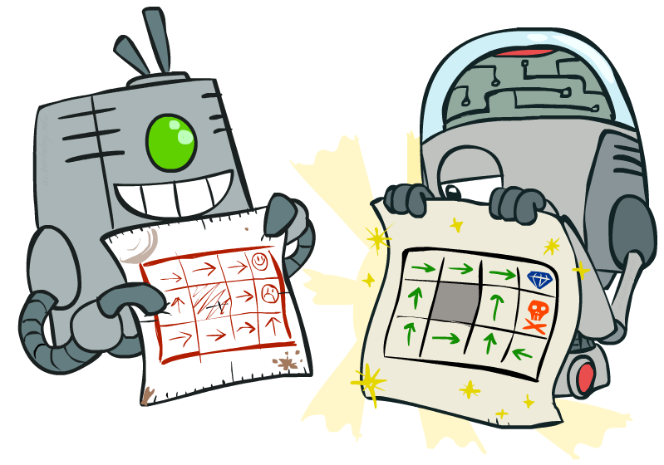
Policy Methods
Notes:
Good policies v. bad policies. Methods to work over policies to make them better, rather than over values.

Slide 70
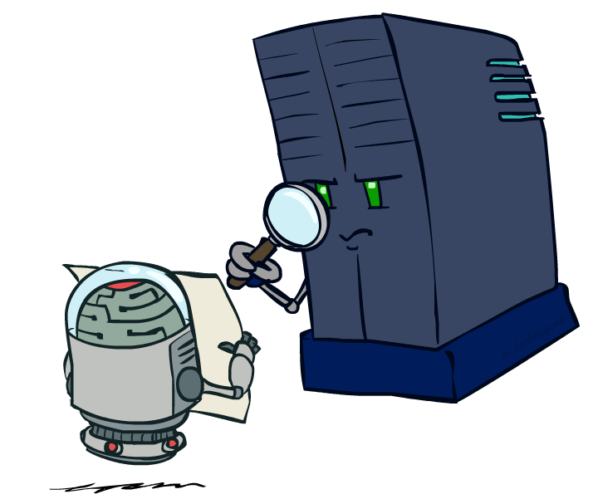
Policy Evaluation
Notes:
Figure out for a policy, what the values are.

Slide 71
Fixed Policies
Do the optimal action
Do what π says to do
s
s
a
π(s)
s, a
s, π(s)
s,a,s’
s, π(s),s’
s’
s’
Expectimax trees max over all actions to compute the optimal values
If we fixed some policy π(s), then the tree would be simpler – only one action per state
… though the tree’s value would depend on which policy we fixed
Notes:
So far we’ve only been talking about executing under optimal actions. That gave us optimal values and therefore optimal behaviors.
Here we’re going to talk about what to do under a fixed policy, pi.
If I have a fixed policy, then I don’t have a lot choices. I don’t have to max over the set of possible actions anymore. Essentially the tree is pruned.

Slide 72
Utilities for a Fixed Policy
Another basic operation: compute the utility of a state s under a fixed (generally non-optimal) policy
Define the utility of a state s, under a fixed policy π:
V^{π}(s) = expected total discounted rewards starting in s and following π
Recursive relation (one-step look-ahead / Bellman equation):
s
π(s)
s, π(s)
s, π(s),s’
s’
Notes:
Under optimal policies one thing we needed to do was to calculate the utility of a state.
We’ll need to do that again. Now it’s actually easier.
We need to write an equation. We used to write a maximum. We don’t need to do that anymore. But we still need to consider all possible outcomes.
The function pi takes in a state and returns an action. It could be implemented in code as a hash table. Same kind of bellman equation, but the max over a is gone. Recursive relation that is a one step look ahead.

Slide 73
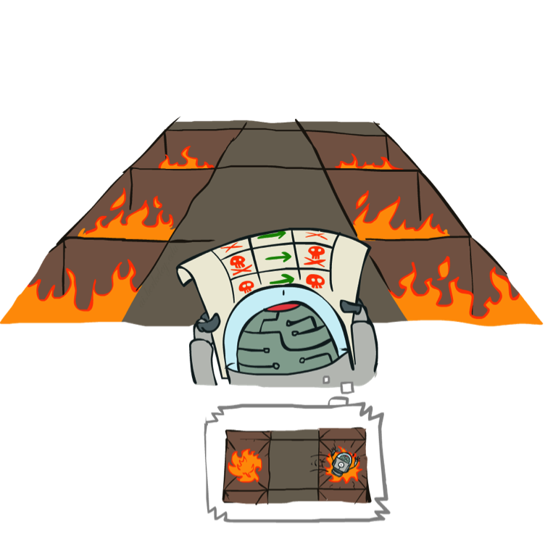
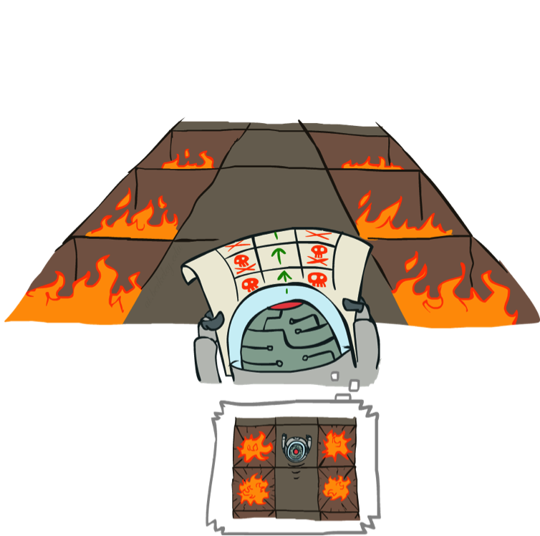
Example: Policy Evaluation
Always Go Right
Always Go Forward
Notes:
Here’s an example of policy evaluation. How about this one? It’s bad. The agent can simulate it in its head and decide that it is bad.
This one looks better. The robot can think about it and decide that it’s better than the previous one.
If it’s got a choice then it will pick this policy.

Slide 74
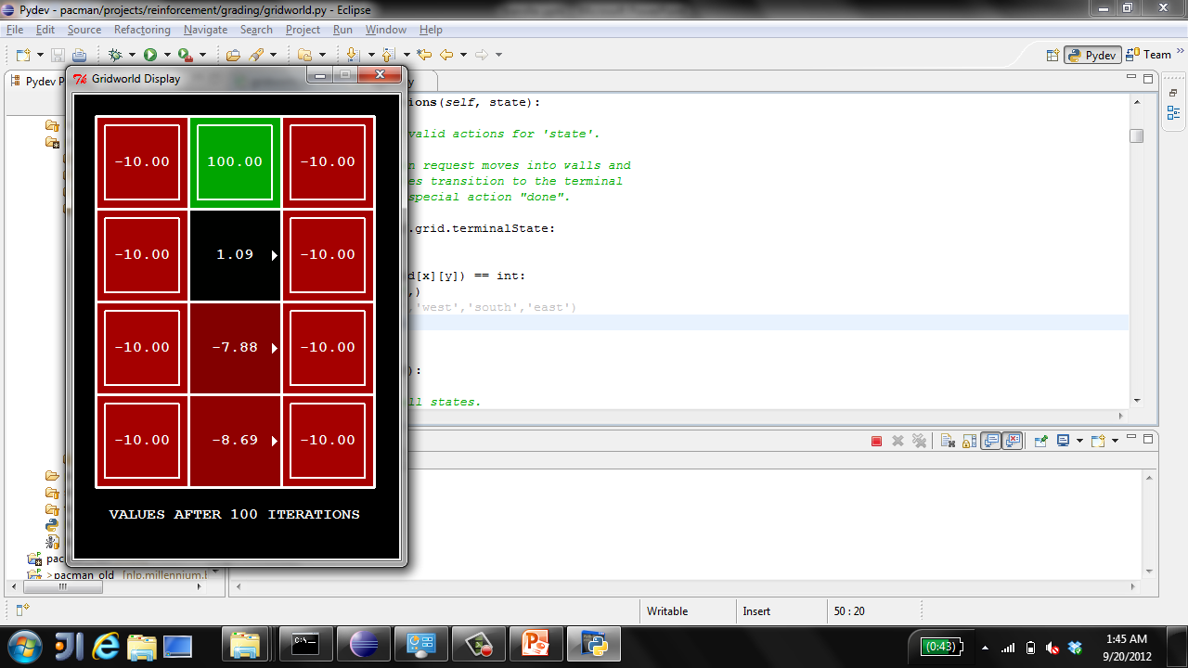
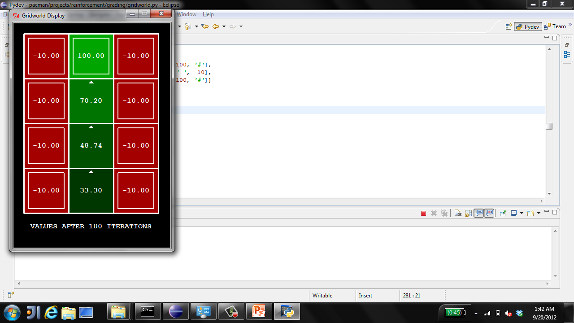
Example: Policy Evaluation
Always Go Right
Always Go Forward
Notes:
Here’s how the values work out.
The always go right one doesn’t work out so well in less you’re on the exit square. But importantly, it has values. So we can evaluate how good it is.
The second has better values.
The reason we want to evaluate policies, is that we will look at algorithms that start with one policy, evaluate it, and then look at ways of improving it.

Slide 75

Policy Evaluation
How do we calculate the V’s for a fixed policy π?
Idea 1: Turn recursive Bellman equations into updates
(like value iteration)
Efficiency: O(S²) per iteration
Idea 2: Without the maxes, the Bellman equations are just a linear system
Solve with Matlab (or your favorite linear system solver)
s
π(s)
s, π(s)
s, π(s),s’
s’
Notes:
One way is to look at it just like value iteration.
At V_0, give 0.
Then recursively, compute it for iteratively higher k.
Imagine I have k+1 time steps left.
Take the action pi of S.
Average over all possible states s’
Add the instantaneous reward R
plus the discounted future reward at the landing state s until the end of time.
This is more efficient than standard value iteration.
For every iteration, we visit each state. The maximum number of possible landing states s’ is s. This assumes that every state is connected to every other state, which is usually not the case, so this is an upper bound on the complexity.
This O(S^2) no longer has the A term.
Without the maxes, you can actually just solve it as a system of linear equations.

Slide 76
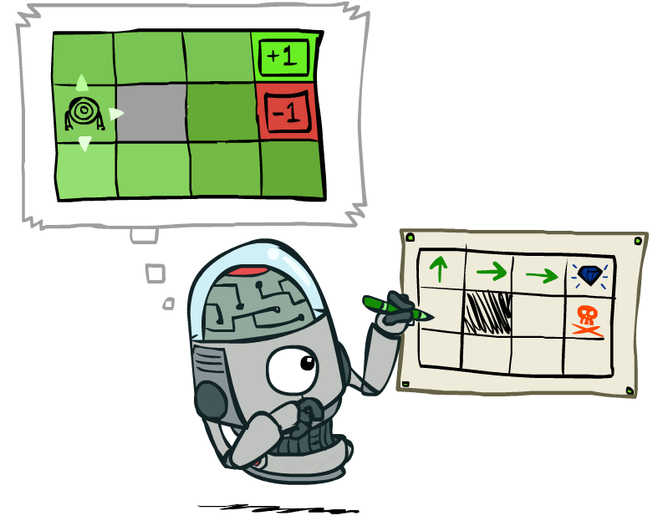
Policy Extraction
Notes:
OK, so we just looked at the situation where we are given a policy, and we need to assign values to it.
Now let’s look at the opposite. Given a set of values (which we assume to be correct), what’s the best policy?

Slide 77
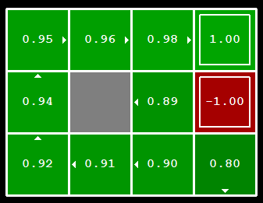
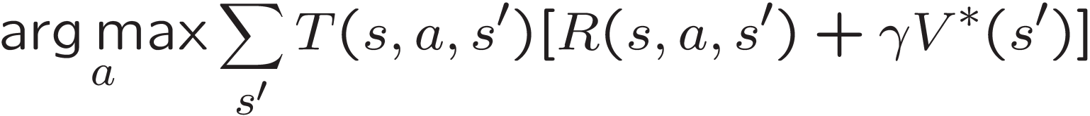
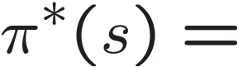
Computing Actions from Values
Let’s imagine we have the optimal values V*(s)
How should we act?
It’s not obvious!
We need to do a mini-expectimax (one step)
This is called policy extraction, since it gets the policy implied by the values
Notes:
Let’s compute the actions to take given the values.
Someone gives us the optimal values.
How should I act?
Look at the interesting square on the ledge.
.89 – that’s not bad. Should I choose to go North? South? It turns out that here we shouldn’t go north to the .98, but we shouldn’t head in that direction. We should hit the wall and wait to move up by chance.
The values let you figure out that the square to the north is better than you, but not how to get there.
So it’s not obvious how to act optimally given the values.
If you didn’t have the helpful arrows here, and you only had the optimal values, how would you figure out how to act.
The answer to that is you basically have to do expectimax.
You have to unroll this and see which was the action that gave rise to these values.
We don’t have to do it very deeply. We’ll see when we unroll it we’ll need to recurse, but we’ve already got those actions, so we only have to go one step deep.
[write equation on the board, initially omitting argmax]
…
The discounted future is given to us, since we have V*(s).
Notation over a is arg max. Instead of giving me the maximum value, it gives me the action a that achieves the maximum.
This one step look ahead according to a given set of values is called policy extraction, since it returns the policy implied by the values.

Slide 78
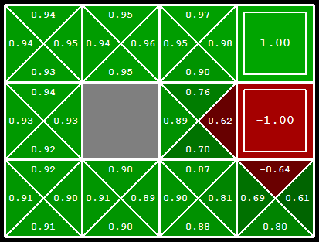
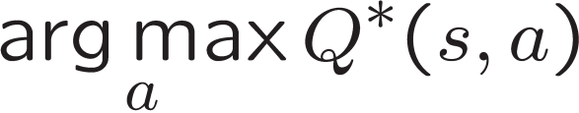
Computing Actions from Q-Values
Let’s imagine we have the optimal q-values:
How should we act?
Completely trivial to decide!
Important lesson: actions are easier to select from q-values than values!
Notes:
What about q-values? This is less intuitive to thing about than the regular values.
Let’s think about the state where we’re on the ledge again. What action should we take now? It’s trivial!
Essentially, they have already unrolled the state for you.
It’s much easier to extract actions from q-values than from values. This is an important lesson, and it’s going to come up again in reinforcement learning.

Slide 79

Policy Iteration
Notes:
Next we’re going to look into an important algorithm called policy iteration. It combines the idea of evaluating a policy with improving that policy based on its values.

Slide 80
Problems with Value Iteration
Value iteration repeats the Bellman updates:
Problem 1: It’s slow – O(S²A) per iteration
Problem 2: The “max” at each state rarely changes
Problem 3: The policy often converges long before the values
s
a
s, a
s,a,s’
s’
[Demo: value iteration (L9D2)]
Notes:
Demo steps through value iteration; snapshots of values shown on next slides.

Slide 81
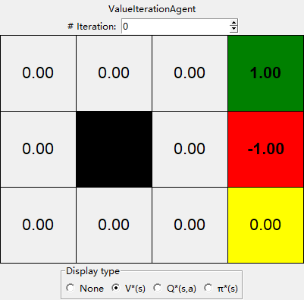
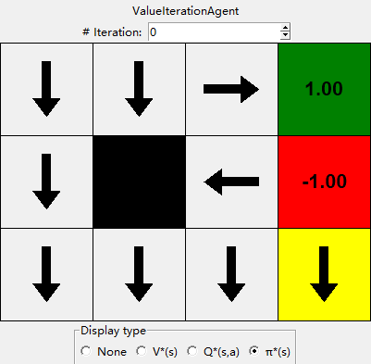
k=0
Noise = 0.2
Discount = 0.9
Living reward = 0
Notes:
At V0 we don’t have any values.
We’re going to walk through this twice. On the first time take a look at the arrows and when they change. At first they change a lot, then they slow down, then most of them don’t change at all after about V7 or V8.
Next look at the values in the bottom left. It takes a long time before the values get high enough to effect the arrows.

Slide 82
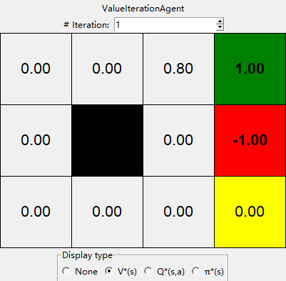
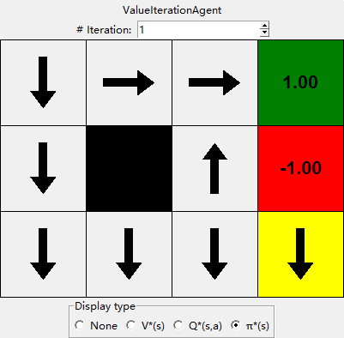
k=1
Noise = 0.2
Discount = 0.9
Living reward = 0
Notes:
We’re going to walk through this twice. On the first time take a look at the arrows and when they change. At first they change a lot, then they slow down, then most of them don’t change at all after about V7 or V8.
Next look at the values in the bottom left. It takes a long time before the values get high enough to effect the arrows.

Slide 83
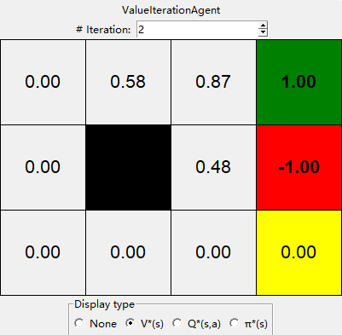
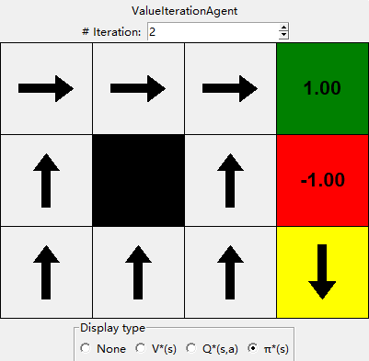
k=2
Noise = 0.2
Discount = 0.9
Living reward = 0
Notes:
We’re going to walk through this twice. On the first time take a look at the arrows and when they change. At first they change a lot, then they slow down, then most of them don’t change at all after about V7 or V8.
Next look at the values in the bottom left. It takes a long time before the values get high enough to effect the arrows.

Slide 84

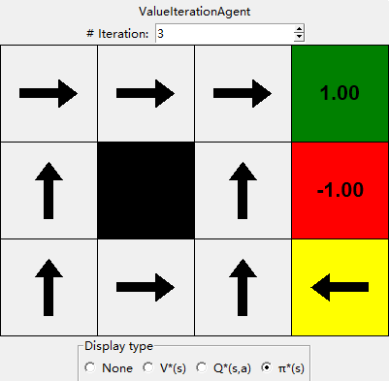
k=3
Noise = 0.2
Discount = 0.9
Living reward = 0
Notes:
We’re going to walk through this twice. On the first time take a look at the arrows and when they change. At first they change a lot, then they slow down, then most of them don’t change at all after about V7 or V8.
Next look at the values in the bottom left. It takes a long time before the values get high enough to effect the arrows.

Slide 85


k=4
Noise = 0.2
Discount = 0.9
Living reward = 0
Notes:
We’re going to walk through this twice. On the first time take a look at the arrows and when they change. At first they change a lot, then they slow down, then most of them don’t change at all after about V7 or V8.
Next look at the values in the bottom left. It takes a long time before the values get high enough to effect the arrows.

Slide 86


k=5
Noise = 0.2
Discount = 0.9
Living reward = 0
Notes:
We’re going to walk through this twice. On the first time take a look at the arrows and when they change. At first they change a lot, then they slow down, then most of them don’t change at all after about V7 or V8.
Next look at the values in the bottom left. It takes a long time before the values get high enough to effect the arrows.

Slide 87

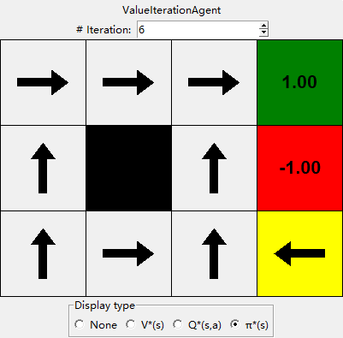
k=6
Noise = 0.2
Discount = 0.9
Living reward = 0
Notes:
We’re going to walk through this twice. On the first time take a look at the arrows and when they change. At first they change a lot, then they slow down, then most of them don’t change at all after about V7 or V8.
Next look at the values in the bottom left. It takes a long time before the values get high enough to effect the arrows.

Slide 88


k=7
Noise = 0.2
Discount = 0.9
Living reward = 0
Notes:
We’re going to walk through this twice. On the first time take a look at the arrows and when they change. At first they change a lot, then they slow down, then most of them don’t change at all after about V7 or V8.
Next look at the values in the bottom left. It takes a long time before the values get high enough to effect the arrows.

Slide 89

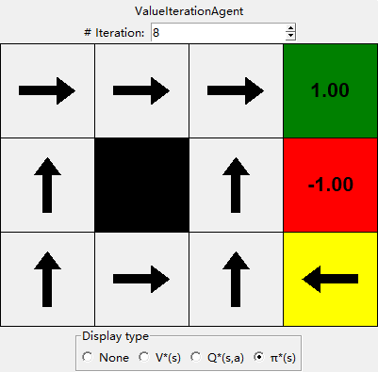
k=8
Noise = 0.2
Discount = 0.9
Living reward = 0
Notes:
We’re going to walk through this twice. On the first time take a look at the arrows and when they change. At first they change a lot, then they slow down, then most of them don’t change at all after about V7 or V8.
Next look at the values in the bottom left. It takes a long time before the values get high enough to effect the arrows.

Slide 90

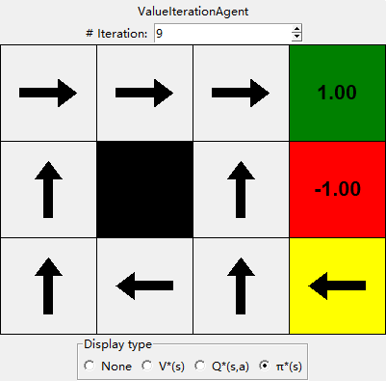
k=9
Noise = 0.2
Discount = 0.9
Living reward = 0
Notes:
We’re going to walk through this twice. On the first time take a look at the arrows and when they change. At first they change a lot, then they slow down, then most of them don’t change at all after about V7 or V8.
Next look at the values in the bottom left. It takes a long time before the values get high enough to effect the arrows.

Slide 91


k=10
Noise = 0.2
Discount = 0.9
Living reward = 0
Notes:
We’re going to walk through this twice. On the first time take a look at the arrows and when they change. At first they change a lot, then they slow down, then most of them don’t change at all after about V7 or V8.
Next look at the values in the bottom left. It takes a long time before the values get high enough to effect the arrows.

Slide 92


k=100
Noise = 0.2
Discount = 0.9
Living reward = 0
Notes:
We’re going to walk through this twice. On the first time take a look at the arrows and when they change. At first they change a lot, then they slow down, then most of them don’t change at all after about V7 or V8.
Next look at the values in the bottom left. It takes a long time before the values get high enough to effect the arrows.

Slide 93
Problems with Value Iteration
Value iteration repeats the Bellman updates:
Problem 1: It’s slow – O(S²A) per iteration
Problem 2: The “max” at each state rarely changes
Problem 3: The policy often converges long before the values
s
a
s, a
s,a,s’
s’
Notes:
[Re-iterate the problems.]
So what can we do?

Slide 94
Policy Iteration
Alternative approach for optimal values:
Step 1: Policy evaluation: calculate utilities for some fixed policy (not optimal utilities!) until convergence
Step 2: Policy improvement: update policy using one-step look-ahead with resulting converged (but not optimal!) utilities as future values
Repeat steps until policy converges
This is policy iteration
It’s still optimal!
Can converge (much) faster under some conditions
Notes:
We’re going to look at an alternate called policy evaluation.

Slide 95
Policy Iteration
Evaluation: For fixed current policy π, find values with policy evaluation:
Iterate until values converge:
Improvement: For fixed values, get a better policy using policy extraction
One-step look-ahead:
Notes:
If we wrote this out in equation, it would look like this.
Step 1 is evaluation. I do this simplified update where I don’t max over the actions. I only do the averaging on the chance nodes. It’s fast, since I don’t consider all of the actions. I do this until it convergences.
Step 2 is the improvement. I do one layer of expectimax. Our truncation function is the old policy. That’s a bit weird right? I’m pushing the old stuff one step into the future and thereby make progress.
If you think about this, the improvement step is just like value iteration. So it’s not going to be very fast. All of the speed gains come from the evaluation step. So we run that many times before allowing an improvement step.

Slide 96
Comparison
Both value iteration and policy iteration compute the same thing (all optimal values)
In value iteration:
Every iteration updates both the values and (implicitly) the policy
We don’t track the policy, but taking the max over actions implicitly recomputes it
In policy iteration:
We do several passes that update utilities with fixed policy (each pass is fast because we consider only one action, not all of them)
After the policy is evaluated, a new policy is chosen (slow like a value iteration pass)
The new policy will be better (or we’re done)
Both are dynamic programs for solving MDPs
Notes:
OK, let’s compare them. They do the same thing. Both take in an MDP. They both output an optimal quality. On the surface they both output optimal values. Policy iteration explicitly outputs the optimal policy, value iteration does it implicitly.
Both are the same class of things. They are dynamic programs for solving MDPs.

Slide 97
Summary: MDP Algorithms
So you want to….
Compute optimal values: use value iteration or policy iteration
Compute values for a particular policy: use policy evaluation
Turn your values into a policy: use policy extraction (one-step lookahead)
These all look the same!
They basically are – they are all variations of Bellman updates
They all use one-step lookahead expectimax fragments
They differ only in whether we plug in a fixed policy or max over actions
Notes:
These are all Bellman equations turned into a one step look ahead.

Slide 98
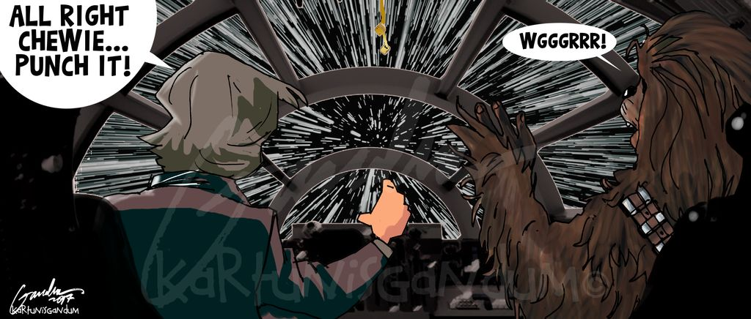

Slide 99
Maximum Expected Utilities

Slide 100
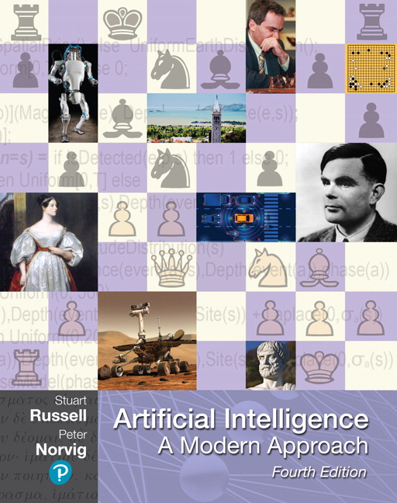
Utilities
Read Chapter 16 of the textbook (sections 16.1-16.3)

Slide 101
Utilities
Notes:
Reading: Chapter 17. Non-deterministic search.
So far, we've mainly examined deterministic problem settings, where the outcome of every action that we take is perfectly predictable. In this module, we'll introduce the notion of a stc. Or probabilistic task environment where the agent will have to figure out what's the best action to take, even when the outcome of that action is uncertain, we'll introduce a new problem formulation called a Markov decision process, or MDP for short.
MDPs are a kind of non-deterministic search problem. They're applicable in a fully observable task environment where we have to make a sequence of decisions. And where the outcome of our actions is non-deterministic. In the previous search problems that we've looked at, the solution has always been a plan.
The plan corresponds to the shortest sequence of actions that we could take to go from our start state to one of our goal states. However, because of the non-determinism in MDPs, that kind of single sequence of actions is not gonna work as a solution . You can imagine that if you executed that sequence of actions, you may end up in a state that isn't a goal state.
Therefore, we're gonna need a different kind of solution to MDPs. A solution for an MDP is gonna be something new called the policy. A policy takes in a state and returns the best action that an agent could take when it finds itself in that. . One way of solving MDPs is via the Expect AAC search algorithm, which we saw in the games and adversarial search module.
We'll also take a look at several other algorithms for solving MDPs, including value iteration and policy iteration. MDPs will also introduce other important concepts like the notion of additive rewards and the notion of a probabilistic transition. , all of the components that we learn about in this MDP module will also be very useful when we reach the reinforcement learning module.

Slide 102
Maximum Expected Utility
Why should we average utilities? Why not minimax?
Principle of maximum expected utility:
A rational agent should choose the action that maximizes its expected utility, given its knowledge
Questions:
Where do utilities come from?
How do we know such utilities even exist?
How do we know that averaging even makes sense?
What if our behavior (preferences) can’t be described by utilities?
Notes:
If we have utilities, why should we ever average them?
The answer is vampire bunnies. Worst case reasoning only works if your model is able to assign very low probabilities to very bad events. You need probabilistic reasoning and averages.
This is going to lead us down the path of probabilistic reasoning.
Are humans so complex that they can’t be boiled down to these probabilities?

Slide 103
Why Expectations?
0
40
20
30
x²
0
1600
400
900
For worst-case minimax reasoning, terminal function scale doesn’t matter
We just want better states to have higher evaluations (get the ordering right)
We call this insensitivity to monotonic transformations
For average-case expectimax reasoning, we need magnitudes to be meaningful
Notes:
Minimax is really about the ordering of the states. A Monotonic transformation is a way of transforming a set of numbers into another set that preserves the order of the original set
In expectiax, the right tree would give me average of 20 and 25, so I would take the right branch. What about in the right tree? That would give me 800 and 650, so I would take the left branch.
The magnitudes are very important here.

Slide 104

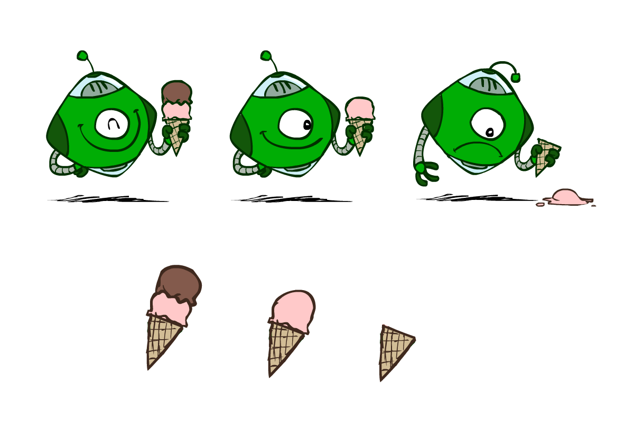
Utilities
Utilities are functions from outcomes (states of the world) to real numbers that describe an agent’s preferences
Where do utilities come from?
In a game, may be simple (+1/-1)
Utilities summarize the agent’s goals
Theorem: any “rational” preferences can be summarized as a utility function
We hard-wire utilities and let behaviors emerge
Why don’t we let agents pick utilities?
Why don’t we prescribe behaviors?

Slide 105
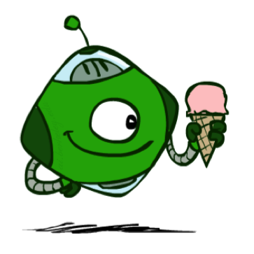
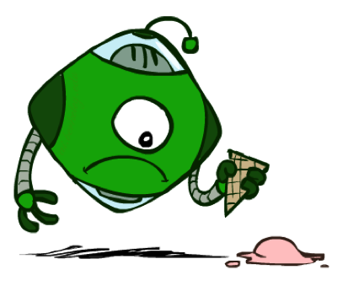
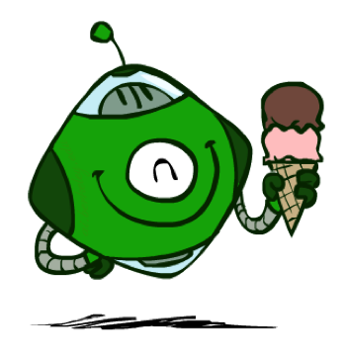
Utilities: Uncertain Outcomes
Getting ice cream
Get Single
Get Double
Oops
Whew!
Notes:
The robot has to choose not only between utilities, but also uncertain outcomes.

Slide 106
Preferences
An agent must have preferences among:
Prizes: A, B, etc.
Lotteries: situations with uncertain prizes
Notation:
Preference:
Indifference:
A Prize
A Lottery
A
p 1-p
A B
Notes:
A prize is a given outcome.
Lotteries are mixtures with probabilities attached.

Slide 107
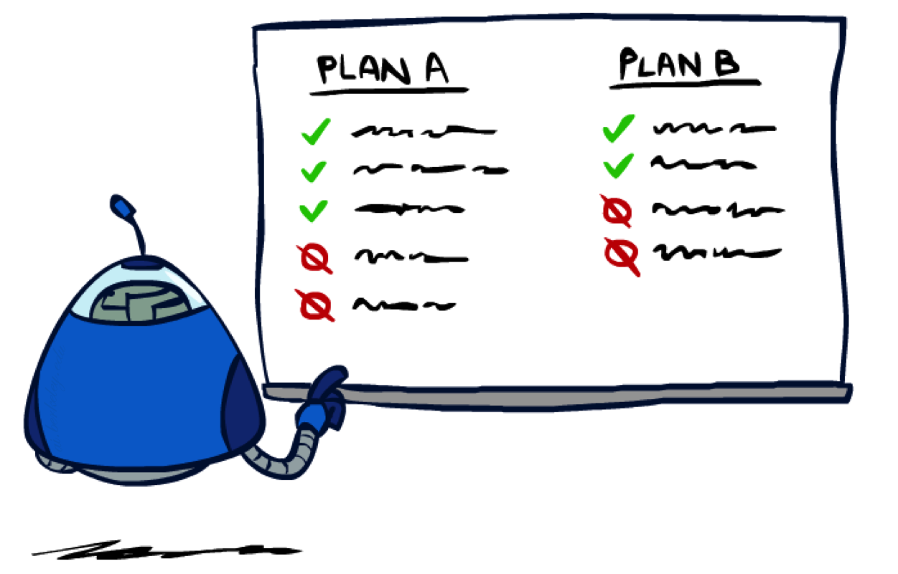
Rationality
Notes:
Are there good preferences and bad preferences? What do we need in order to decide is an agent is rational?

Slide 108
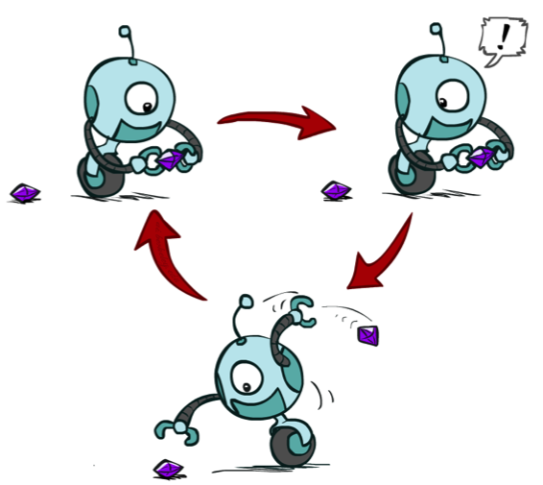
Rational Preferences
We want some constraints on preferences before we call them rational, such as:
For example: an agent with intransitive preferences can
be induced to give away all its money
If B > C, then an agent with C would pay (say) 1 cent to get B
If A > B, then an agent with B would pay (say) 1 cent to get A
If C > A, then an agent with A would pay (say) 1 cent to get C
Axiom of Transitivity: (A > B) ^ (B > C) -> (A > C)
Notes:
Apple, banana, carrot
Some things don’t make sense.
... This is a defect in behavior.

Slide 109


Rational Preferences
The Axioms of Rationality
Theorem: Rational preferences imply behavior describable as maximization of expected utility
Notes:
Orderability. You have to like A better or B better or be indifferent.
Transitivity, we just saw.
Continuity. More subtle. If you like A better than C and B is somewhere in the middle. Then there has to be some lottery between A and C, where you’re indifferent with B.
Substitutability. If they’re exchangeable on their own then they are exchangeable in a lottery.
Monotonicity. Also reasonable. If A is better than B, and you have a lottery between A and B, then you would prefer more A in the mix.
If you accept these actions, then rational preferences that obey these, then all of your behavior is describable by maximizing utilities.

Slide 110


MEU Principle
Theorem [Ramsey, 1931; von Neumann & Morgenstern, 1944]
Given any preferences satisfying these constraints, there exists a real-valued function U such that:
I.e. values assigned by U preserve preferences of both prizes and lotteries!
Maximum expected utility (MEU) principle:
Choose the action that maximizes expected utility
Note: an agent can be entirely rational (consistent with MEU) without ever representing or manipulating utilities and probabilities
E.g., a lookup table for perfect tic-tac-toe, a reflex vacuum cleaner
Notes:
Here’s the theorem.
There exists a real valued function U with the following properties.
U captures your ordinal preferences.
Utility of a lottery is the expectation of the elements of the lottery.
This means the utility captures your preference not only between prizes, but between lotteries!
It’s amazing! It means your utilities are preserved under expectation.
You want your BEHAVIORS to be consistent to the MEU Princple.

Slide 111

Human Utilities
Notes:
You can be represented with utilities! And MEU.

Slide 112

Utility Scales
Normalized utilities: u₊ = 1.0, u₋ = 0.0
Micromorts: one-millionth chance of death, useful for paying to reduce product risks, etc.
QALYs: quality-adjusted life years, useful for medical decisions involving substantial risk
Note: behavior is invariant under positive linear transformation
With deterministic prizes only (no lottery choices), only ordinal utility can be determined, i.e., total order on prizes
Notes:
These are kind of morbid. Reason about product recalls, where you’re talking about chance of death.
How do I actually get the real valued numbers that you assign to U?
I need to ask you questions about lotteries….

Slide 113
Utility Scales
Normalized utilities: u₊ = 1.0, u₋ = 0.0
Micromorts: one-millionth chance of death, useful for paying to reduce product risks, etc.
QALYs: quality-adjusted life years, useful for medical decisions involving substantial risk
Notes:
These are kind of morbid. Reason about product recalls, where you’re talking about chance of death.
How do I actually get the real valued numbers that you assign to U?
I need to ask you questions about lotteries….

Slide 114
Micromort examples
Death from | Micromorts per exposure
Scuba diving | 5 per dive
Skydiving | 7 per jump
Base-jumping | 430 per jump
Climbing Mt. Everest | 38,000 per ascent
1 Micromort
Train travel | 6000 miles
Jet | 1000 miles
Car | 230 miles
Walking | 17 miles
Bicycle | 10 miles
Motorbike | 6 miles
Notes:
Everest = nearly a 4% chance of death.
Willingness to pay[edit]
An application of micromorts is measuring the value that humans place on risk: for example, one can consider the amount of money one would have to pay a person to get him or her to accept a one-in-a-million chance of death (or conversely the amount that someone might be willing to pay to avoid a one-in-a-million chance of death). When put thus, people claim a high number but when inferred from their day-to-day actions (e.g., how much they are willing to pay for safety features on cars) a typical value is around $50 (in 2009).^{[31][32]} However utility functions are often not linear, i.e. the more a person has already spent on their safety the less they are willing to spend to further increase their safety. Therefore, the $50 valuation should not be taken to mean that a human life (1 million micromorts) is valued at $50,000,000. Furthermore, the local linearity of any utility curve means that the micromort is useful for small incremental risks and rewards, not necessarily for large risks.^{[32]}

Slide 115



Human Utilities
Utilities map states to real numbers. Which numbers?
Standard approach to assessment (elicitation) of human utilities:
Compare a prize A to a standard lottery L_{p} between
“best possible prize” u₊ with probability p
“worst possible catastrophe” u₋ with probability 1-p
Adjust lottery probability p until indifference: A ~ L_{p}
Resulting p is a utility in [0,1]
Pay $50
0.999999 0.000001
No change
Instant death
Notes:
Elicit preferences.
Slide the value until the person becomes indifferent. That’s the way that I can assign a number to U.
How much do you NOT want to pay $50? No change is better than paying $50, instant death is worse. Example: Buy a bike helmet to reduce your micromorts by 1.
Once I find that magical probability that makes you indifferent, then I know U.
If we made it worse, pay $5m be in debt forever.

Slide 116


Money
Money does not behave as a utility function, but we can talk about the utility of having money (or being in debt)
Given a lottery L = [p, $X; (1-p), $Y]
The expected monetary value EMV(L) is p*X + (1-p)*Y
U(L) = p*U($X) + (1-p)*U($Y)
Typically, U(L) < U( EMV(L) )
In this sense, people are risk-averse
When deep in debt, people are risk-prone
Notes:
How about money? Can we use money as a utility scale? No! It’s not a good utility scale. We can talk about the utility of money, but it itself isn’t a good utility scale. Why not?
Imagine a lottery where you get X dollars or Y dollars.
Obviously, how good this is depends on X, Y and p.
Typically a utility of a lottery over money is worth less than its equivalent monetary value.
You’d rather have a smaller amount that is guaranteed.
How many of you would like a million dollars?
How many of you would like a billion dollars? How much more? 1000x more? Maybe not?
Let’s say I gave you a billion. Now how much do you want a million? Not much.
Diminishing returns. I’m told after your first billion, your second billion has less utility.
Same thing in the negative. Once you’re $1b in debt, whatever, you’re too big.

Slide 117

Example: Insurance
Consider the lottery [0.5, $1000; 0.5, $0]
What is its expected monetary value? ($500)
What is its certainty equivalent?
Monetary value acceptable in lieu of lottery
$400 for most people
Difference of $100 is the insurance premium
There’s an insurance industry because people will pay to reduce their risk
If everyone were risk-neutral, no insurance needed!
It’s win-win: you’d rather have the $400 and the insurance company would rather have the lottery (their utility curve is linear and they have many lotteries)
Notes:
Lottery example = $1000 computer, 50% chance that you’ll get it stolen, in which case you are left with $0.
Certainty equivalent. That’s how much money you would be willing to trade this lottery for. Trade uncertainty for certainty.
Certainty equivalent. How much would you trade this lottery for? How many would trade this for $10? How about $900? How about $400?
Because of these preferences there are things like insurance.
Is insurance just a scam? No, it’s win-win!

Slide 118

Example: Human Rationality?
Famous example of Allais (1953)
A: [0.8, $4k; 0.2, $0]
B: [1.0, $3k; 0.0, $0]
C: [0.2, $4k; 0.8, $0]
D: [0.25, $3k; 0.75, $0]
Most people prefer B > A, C > D
But if U($0) = 0, then
B > A ⇒ U($3k) > 0.8 U($4k)
C > D ⇒ 0.8 U($4k) > U($3k)
Notes:
Are humans perfectly rational? Here’s a classic experiment
B is the clear winner.
C is the winner.
Most people prefer C over D.
Multiply C and D by 4 and get the opposite conclusion 0.2*4 = 0.8, 0.25*4 = 1, so 0.8 U($4k) > 1.0 * U($3k)
So what the heck? You’re making irrational preferences? Are you irrational or did I do something wrong?
There’s a lot going on.
Prize B said 100% chance of 3k. 0 is actually important.
What do you get if you choose A, and you win $0? You get the feeling of stupidity.

